Slide 1
CZ1015 FSP1 TEAM 3
Group Members:
Jonathan Chan
Shyam Sundar
Soh Qian Yi
Ye Ziyuan

Slide 2

Jester Jokes -
Data Set
Build a recommendation system for users

Slide 3
Overview
Introduction
Cleaning of Dataset
Simple Recommender System
User-to-User Recommender System
Collaborative Filtering
Visualisation

Slide 4

Recommendation System
Simple Recommender System
User-to-User Recommender System

Slide 5
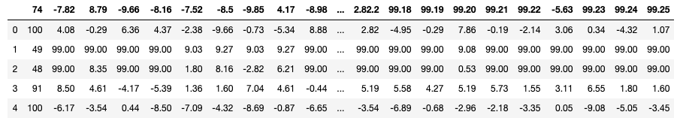
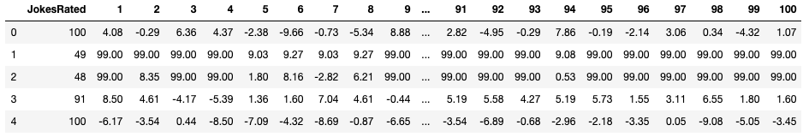
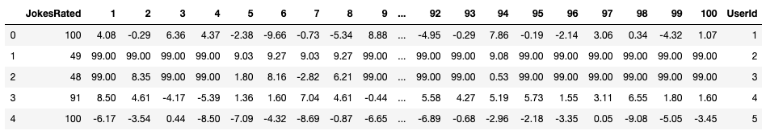
Cleaning the Data

Slide 6
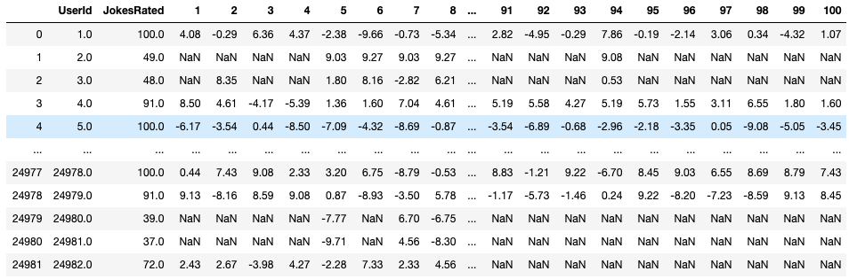
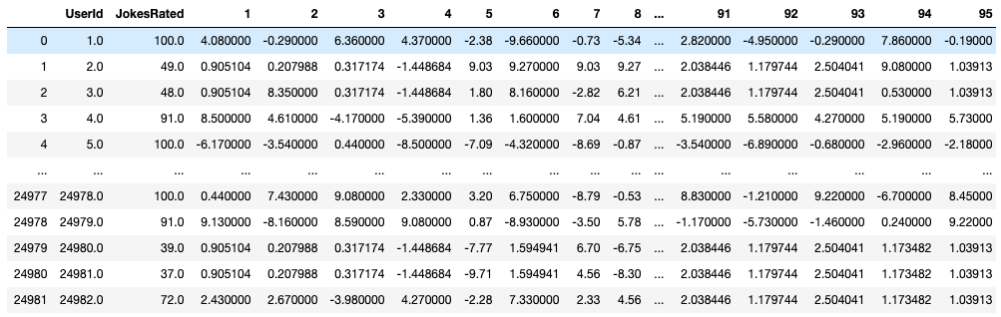
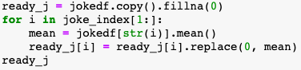
Replacing previously ‘99’s to NaN
Replacing NaN with the mean of each joke

Slide 7
Simple Recommender System

Slide 8
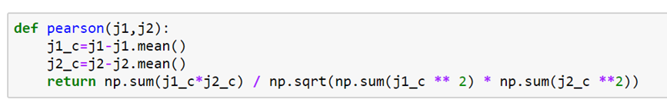
The aim of this recommendation system is to just provide the user, recommended jokes based on user preference of a particular joke.
This is carried out using the Pearson’s correlation coefficient for which a function ‘pearson’ was created.

Slide 9
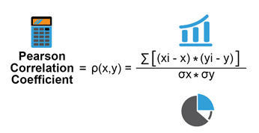
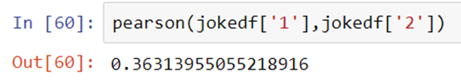
The correlation between two jokes is obtained by sending in the two jokes as parameters to the function ‘pearson’.
Let us assume that the user likes Joke 1.
In the function, the value of each row under a particular column is compared against the mean of that column.
Then using this formula, the correlation of the two jokes is calculated and returned.

Slide 10
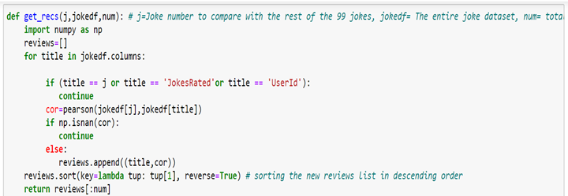
To manually check the correlation of one joke with every other joke in the dataset would be time-consuming and inefficient.
The function below helps to automate this and speed things up.

Slide 11
The ‘get_recs’ function helps to compare the a joke with every other joke in the dataset and return the correlation values with respect to every joke by calling the ‘pearson’ function previously written.
During its execution, it makes sure to ignore the columns ‘JokesRated’ and ‘UserId’ as well as the column name of the joke we are comparing against ( In our example, we are using Joke 1 as user input).
Function Parameters for the ‘get_recs’ function:
j = refers to the joke we are comparing against
jokedf = the cleaned joke dataset
num = total number of jokes in the dataset

Slide 12
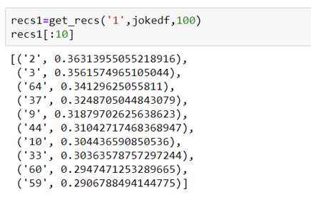
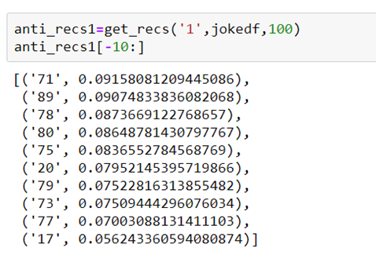
Now we call the ‘get_recs’ function to provide the top 10 jokes with highest correlation with respect to Joke 1 and then pass it to ‘recs1’.
Similarly, we call the ‘get_recs’ function to provide the 10 jokes with lowest correlation with respect to Joke 1 and then pass it to ‘anti_recs1’. This means that if the user likes Joke 1, he/she would probably not like the jokes in ‘anti_recs1’.

Slide 13
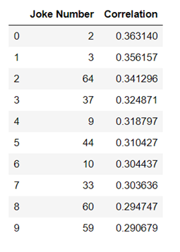
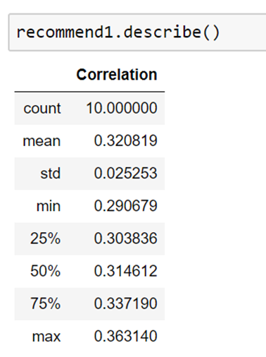
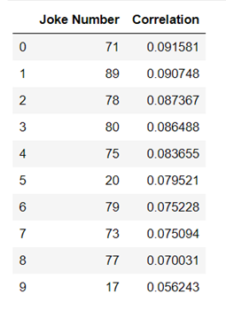
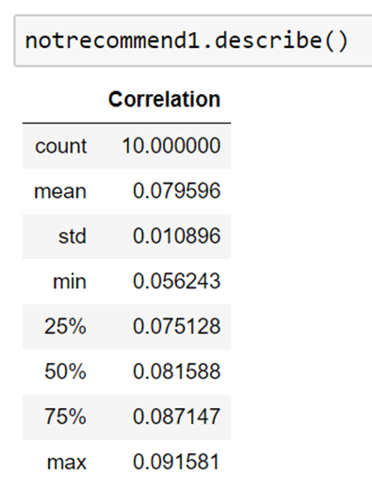
‘recommend1’ - dataframe for better visualisation of ‘recs1’.
‘notrecommend1’ - dataframe for better visualisation of ‘anti_recs1’.

Slide 14
Now a correlation heatmap is plotted which acts as a second layer of check in order to ensure that the user will indeed enjoy the jokes suggested. This is done by plotting a heatmap comparing every suggested joke with each other.

Slide 15
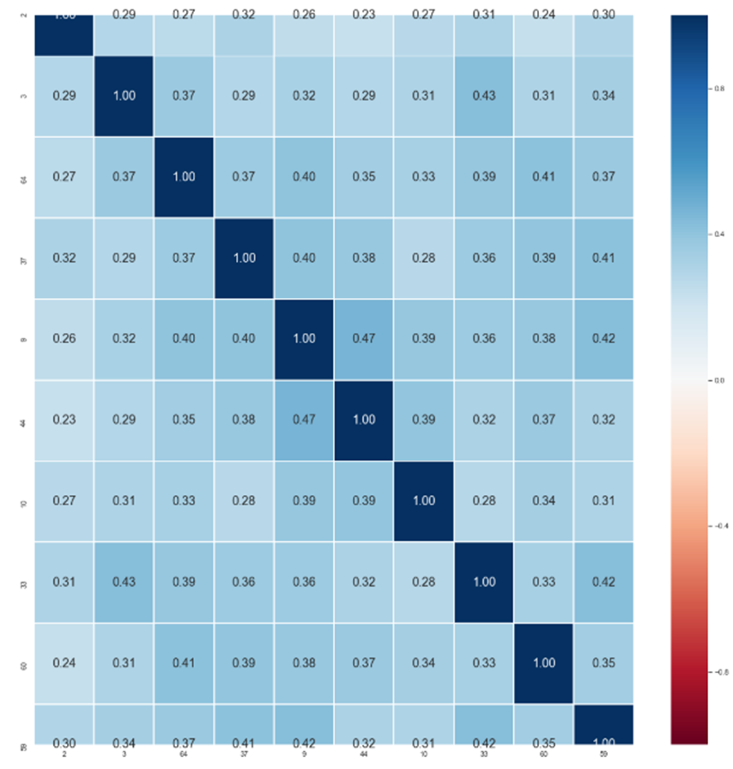

Slide 16
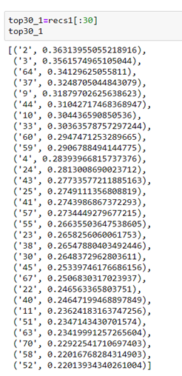
As well as this system works, it is still a very simple recommender system. Having to recommend jokes to the user based on a SINGLE joke that the user likes, might not be that accurate. So if the user provides more jokes that he/she likes, then the suggestions can be better informed ones.
For this example, let us assume that the user likes Joke 5 as well.
The process followed to tackle this:
Find the top 30 most correlated jokes with respect to Joke 1.

Slide 17
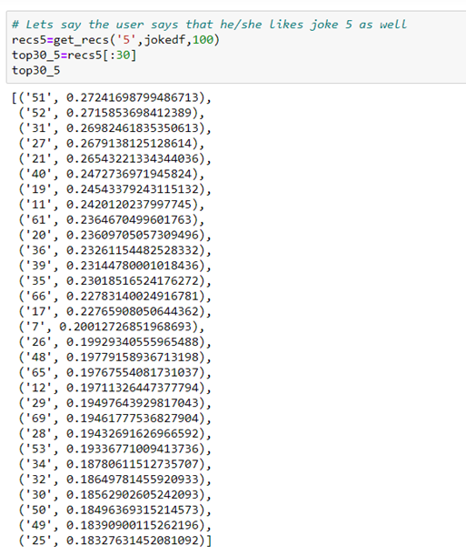
Find the top 30 most correlated jokes with respect to Joke 5.

Slide 18
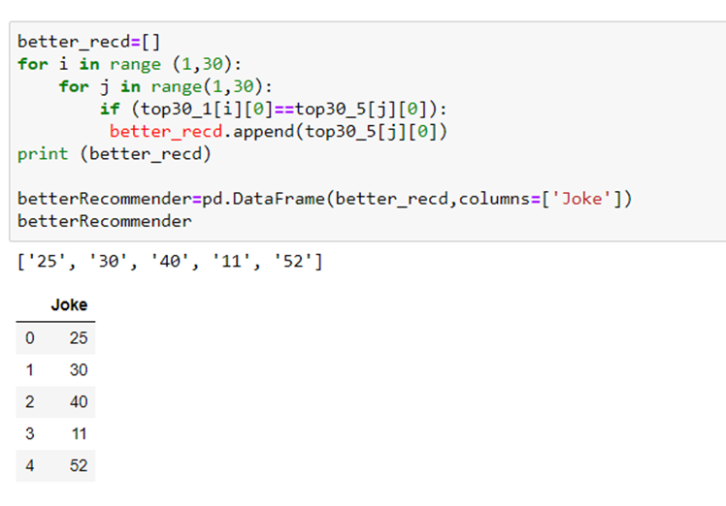
Find the jokes that are common to both lists and provide a better informed recommendation of jokes.

Slide 19
User-to-User Recommender System

Slide 20
User-to-User recommender system
given a user id x
use the top 10 most liked jokes by user x to find the users who have the similar taste
based on 100 similar users, recommend twenty jokes for user x

Slide 21
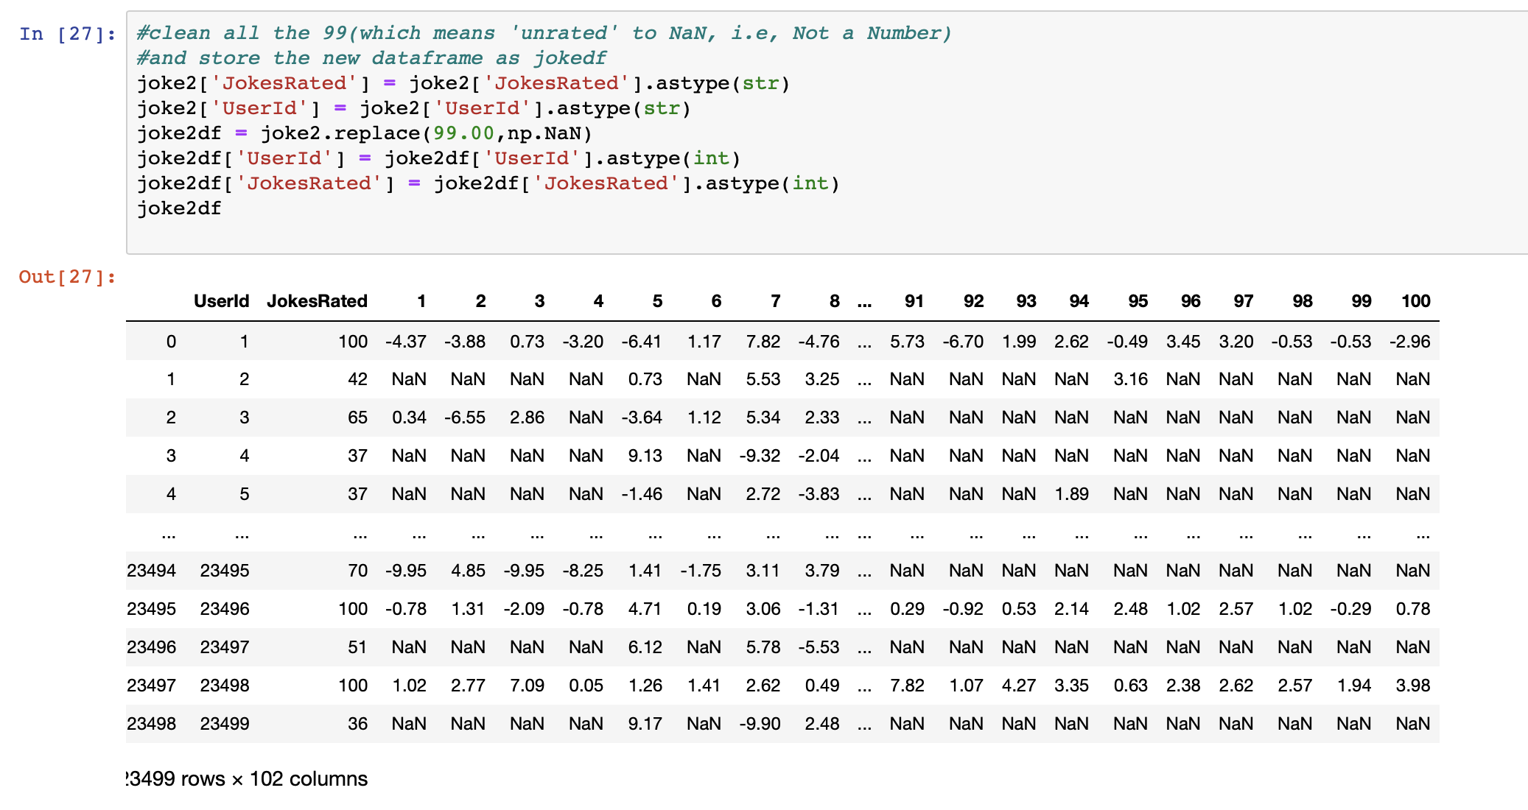
Recommend 20 jokes to a user:
1. Prepare data set ‘jester-joke-2’ as a test set

Slide 22
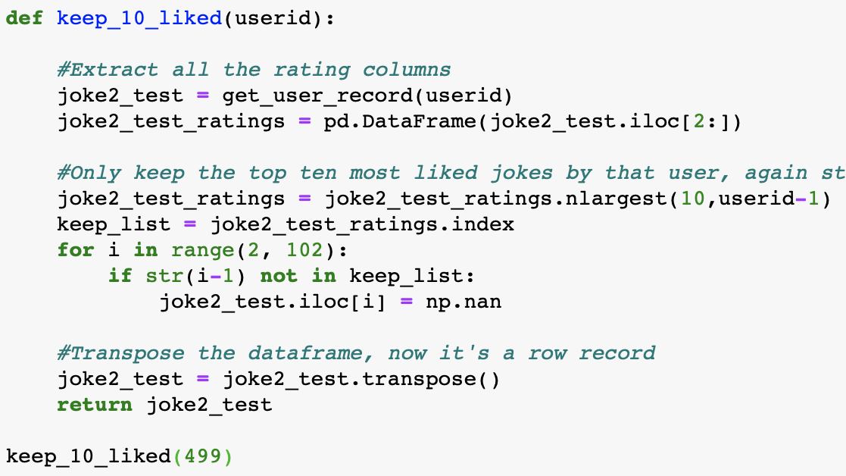

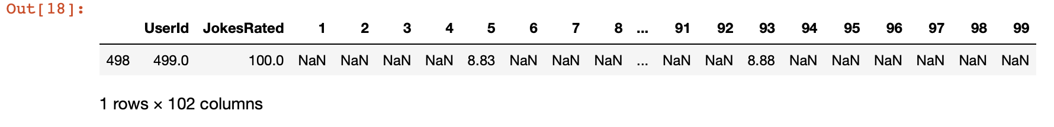
2. Extract a single user record;
Keep the top ten liked jokes of that user

Slide 23
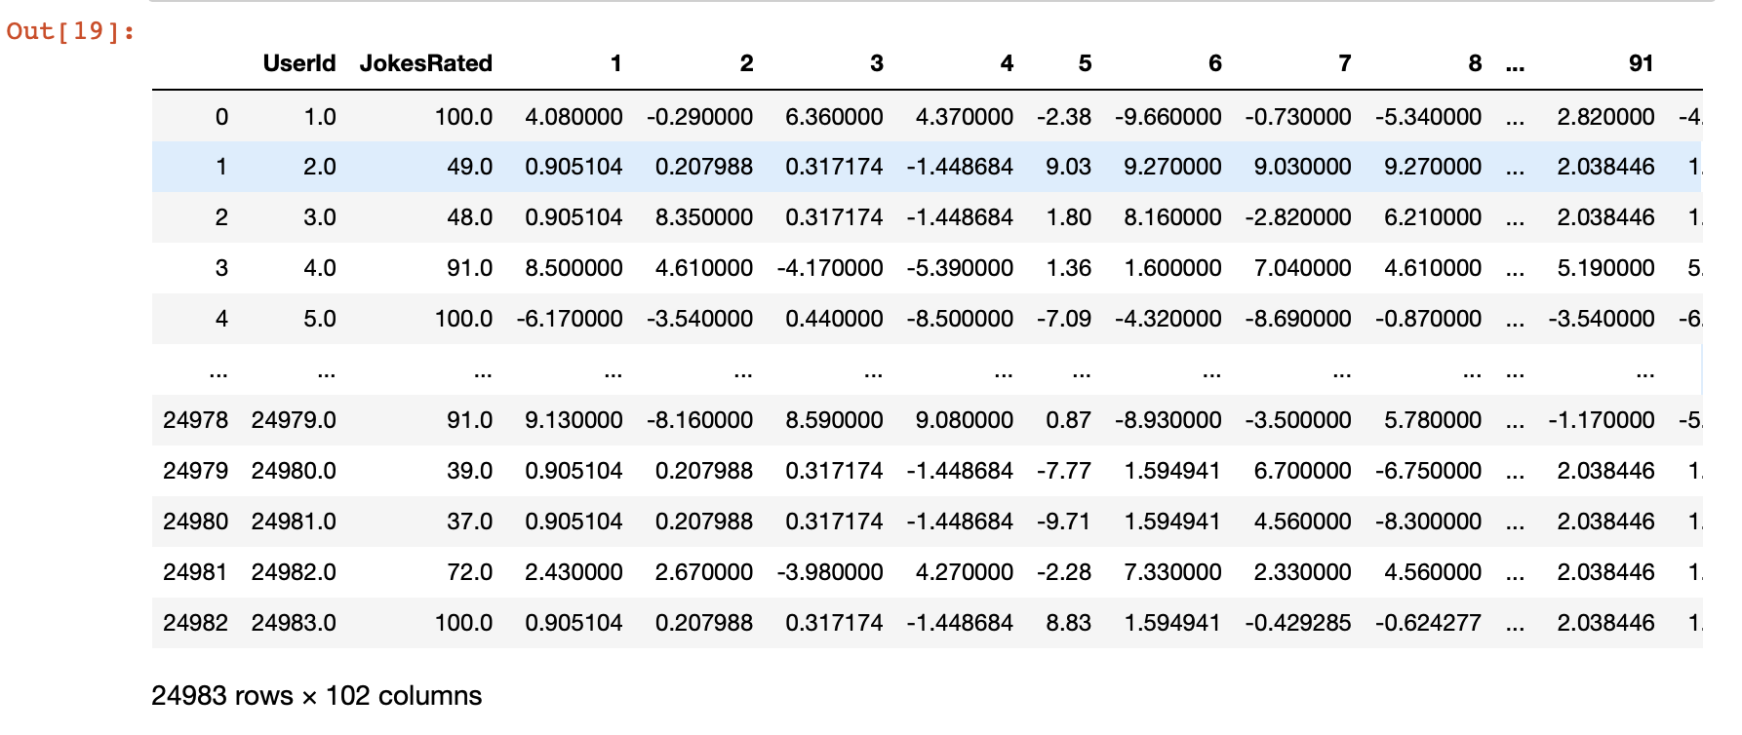
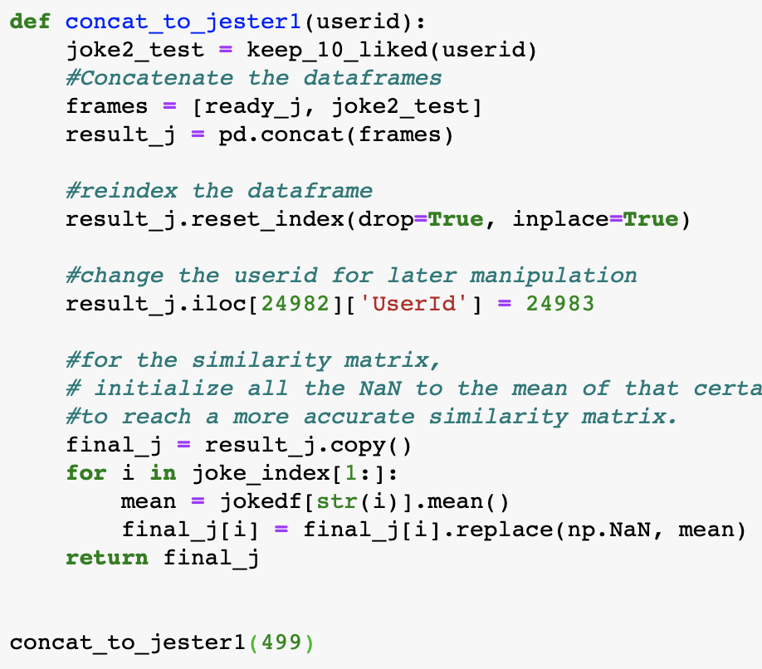
3. Append the user record to jester-joke-1 data frame;
Replace the NaN’s with the corresponding means

Slide 24
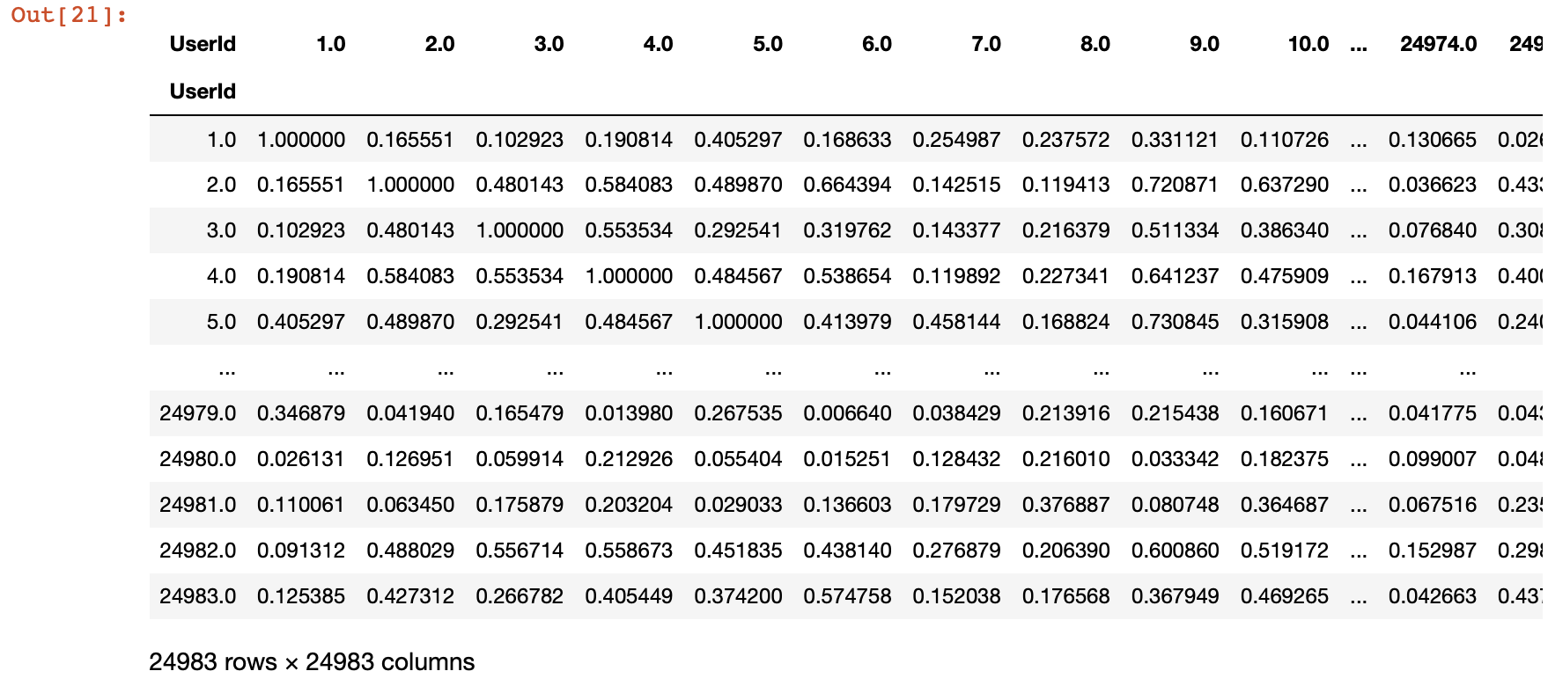
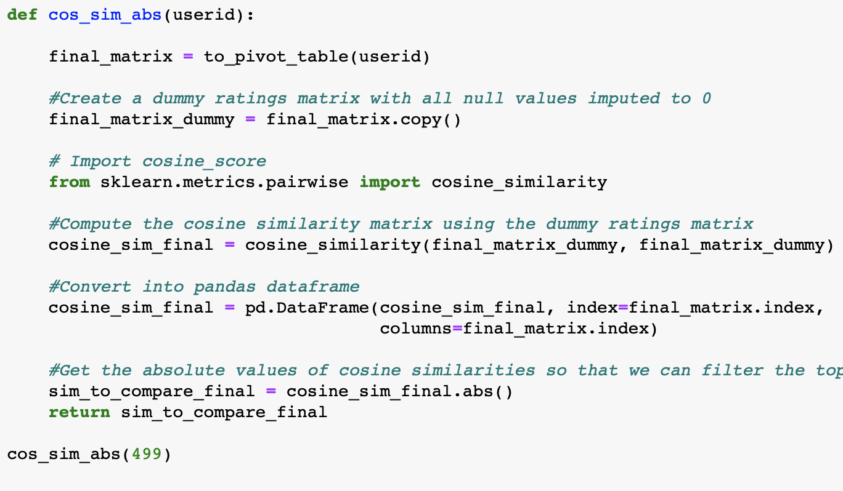
4. Cosine similarity between users; transfer to absolute values

Slide 25
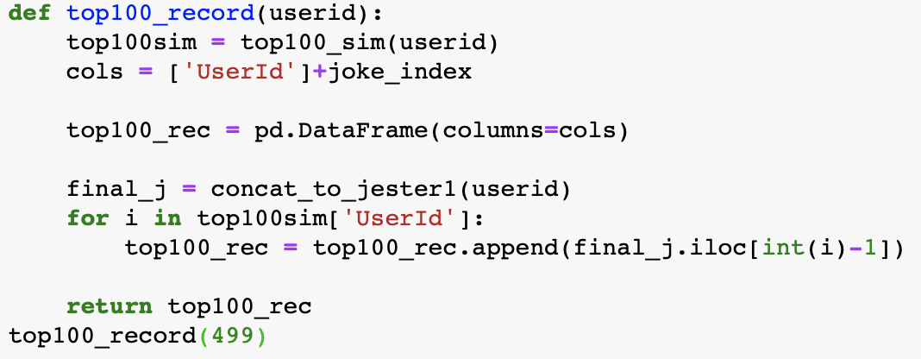
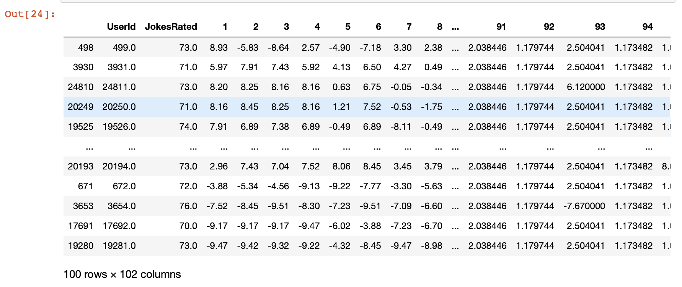
5. Get the top 100 similar users and all their ratings

Slide 26
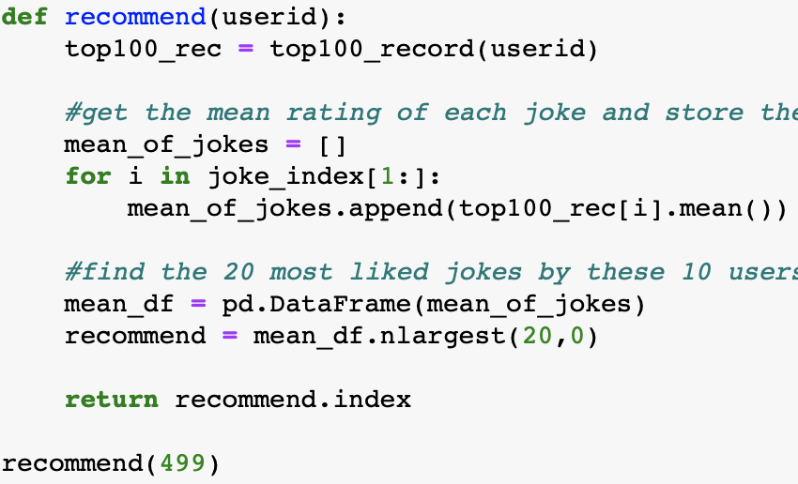
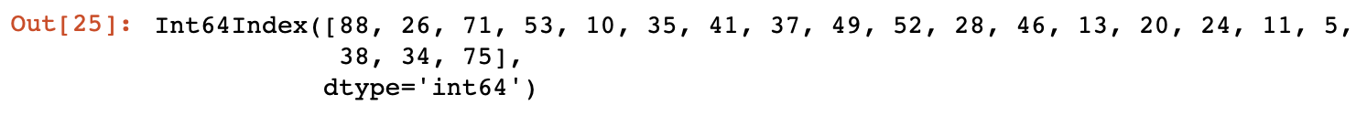
6. Recommend 20 jokes based on similar users

Slide 27
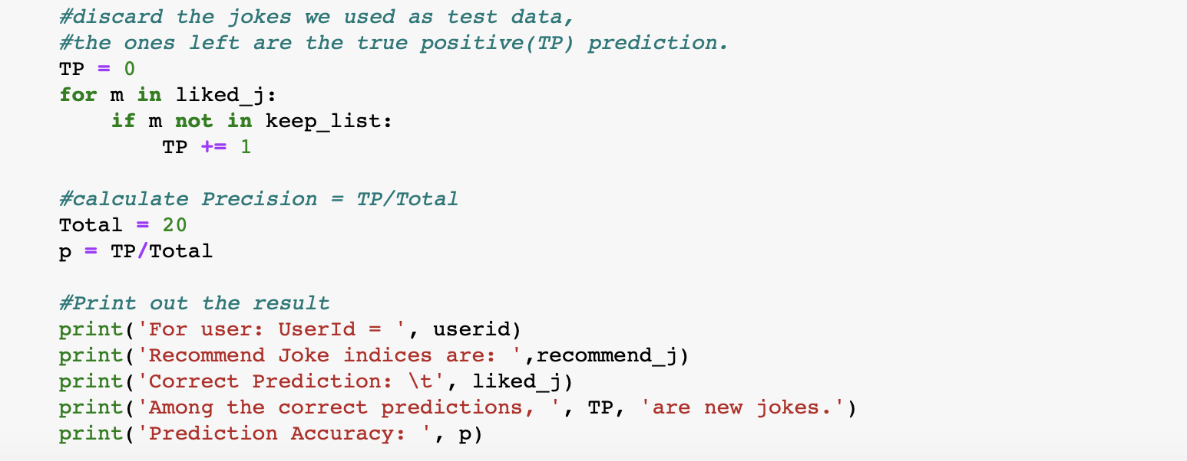
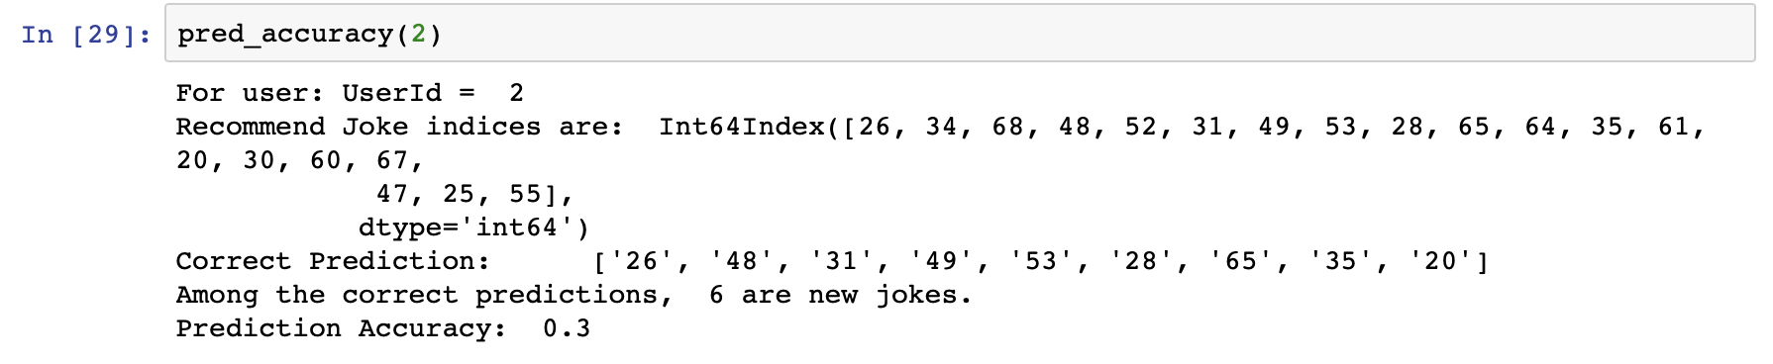
7. Prediction accuracy?

Slide 28
User-to-User Collaborative Filtering

Slide 29
User-to-User Collaborative Filtering
For a test user,
Calculate the mean & weighted mean ratings of similar users in train set
predict the rating of joke by a test user

Slide 30
Framework

Slide 31
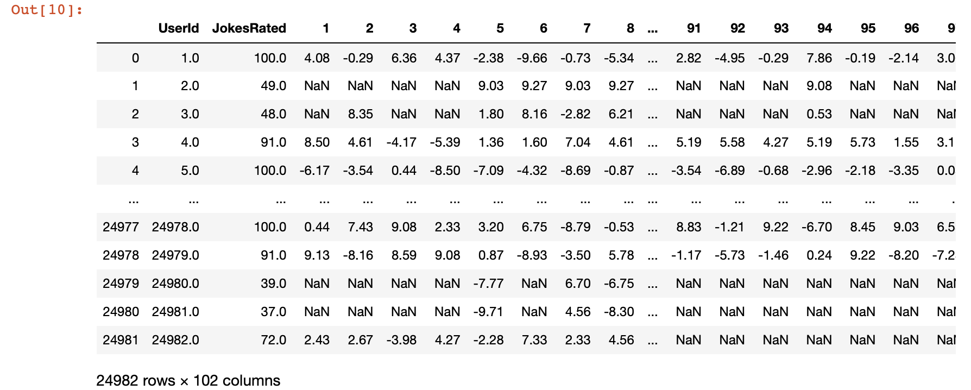
1. Start with ‘jester-joke-1’

Slide 32
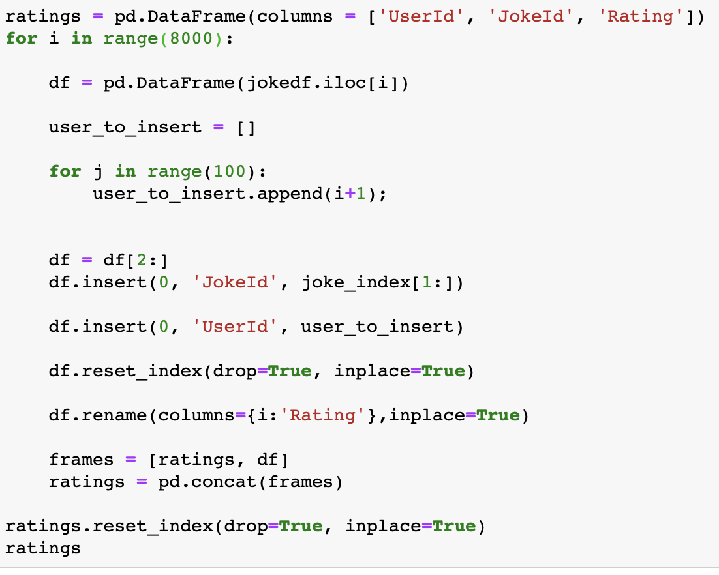
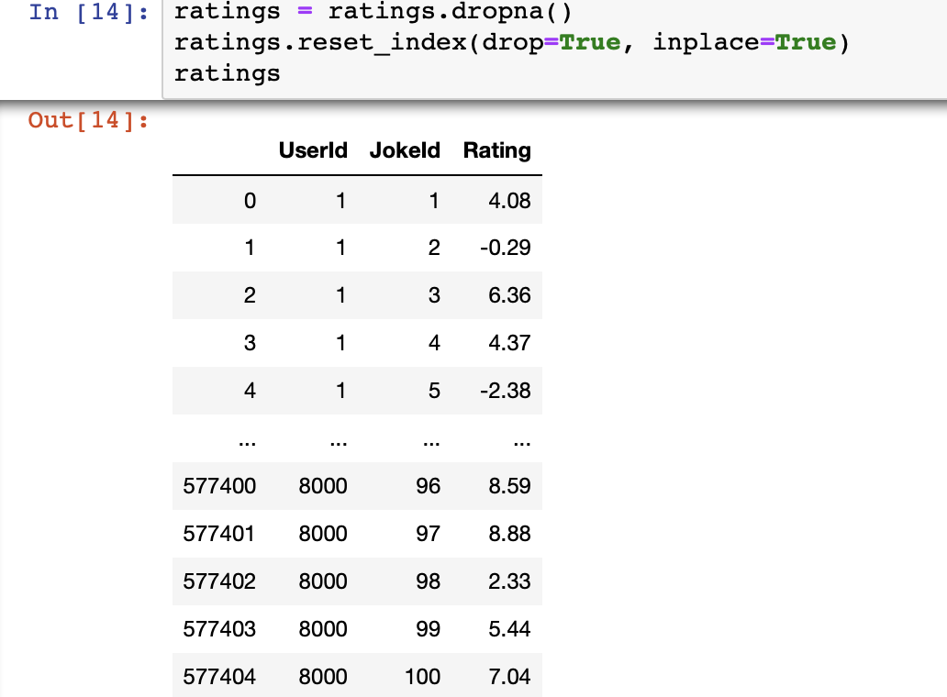
2. Reshape the df; Store it as a new df

Slide 33
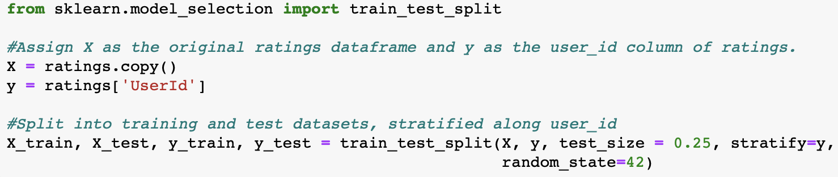
3. train_test_split: train : test = 3 : 1.
(random 75%)

Slide 34
Collaborative Filtering: By Mean

Slide 35
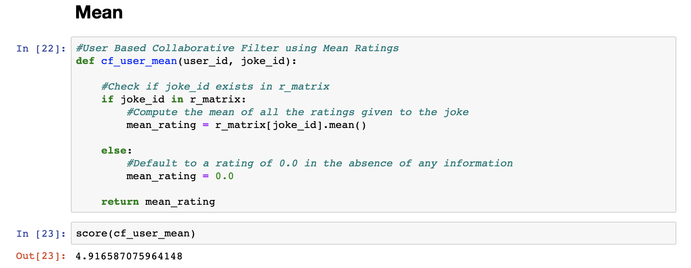
5. User Based Collaborative Filter
using Mean Ratings

Slide 36
Collaborative Filtering: By Weighted Mean

Slide 37
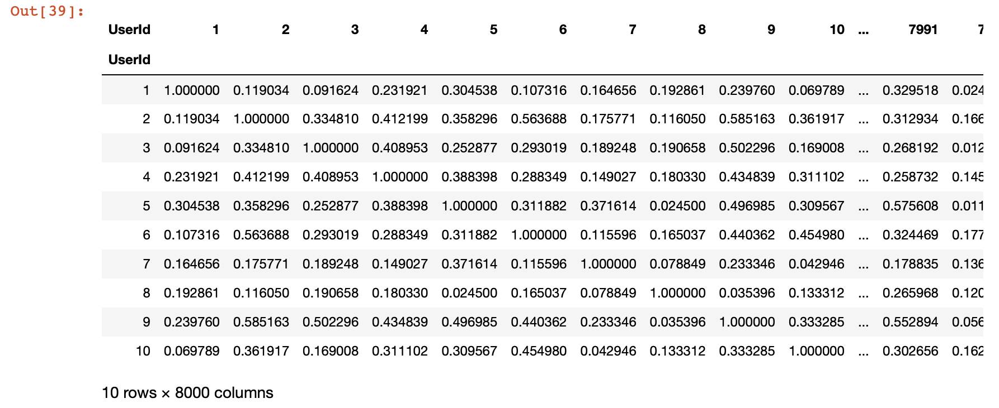
6. Using Weighted Mean Ratings:
cosine_similarity as the weight

Slide 38
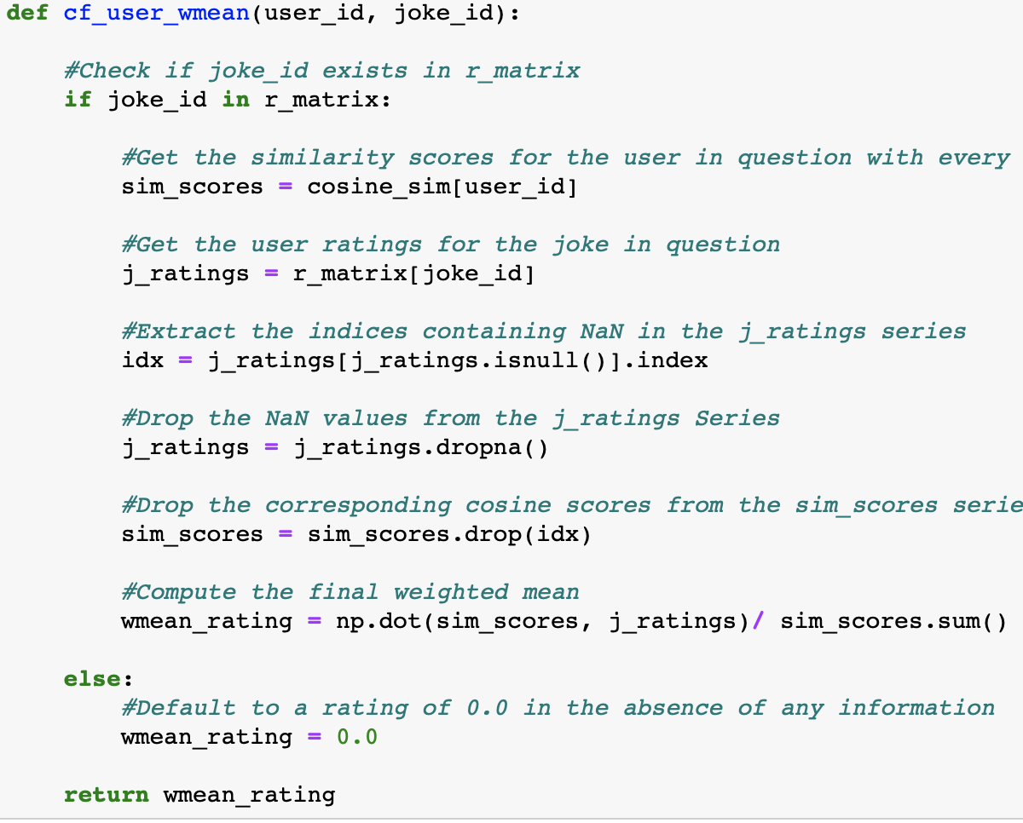
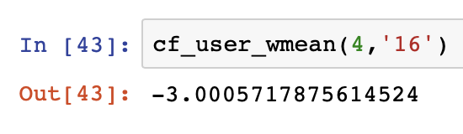
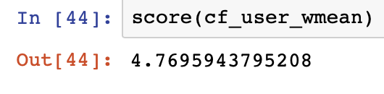
7. Using Weighted Mean Ratings

Slide 39
Visualization by User

Slide 40
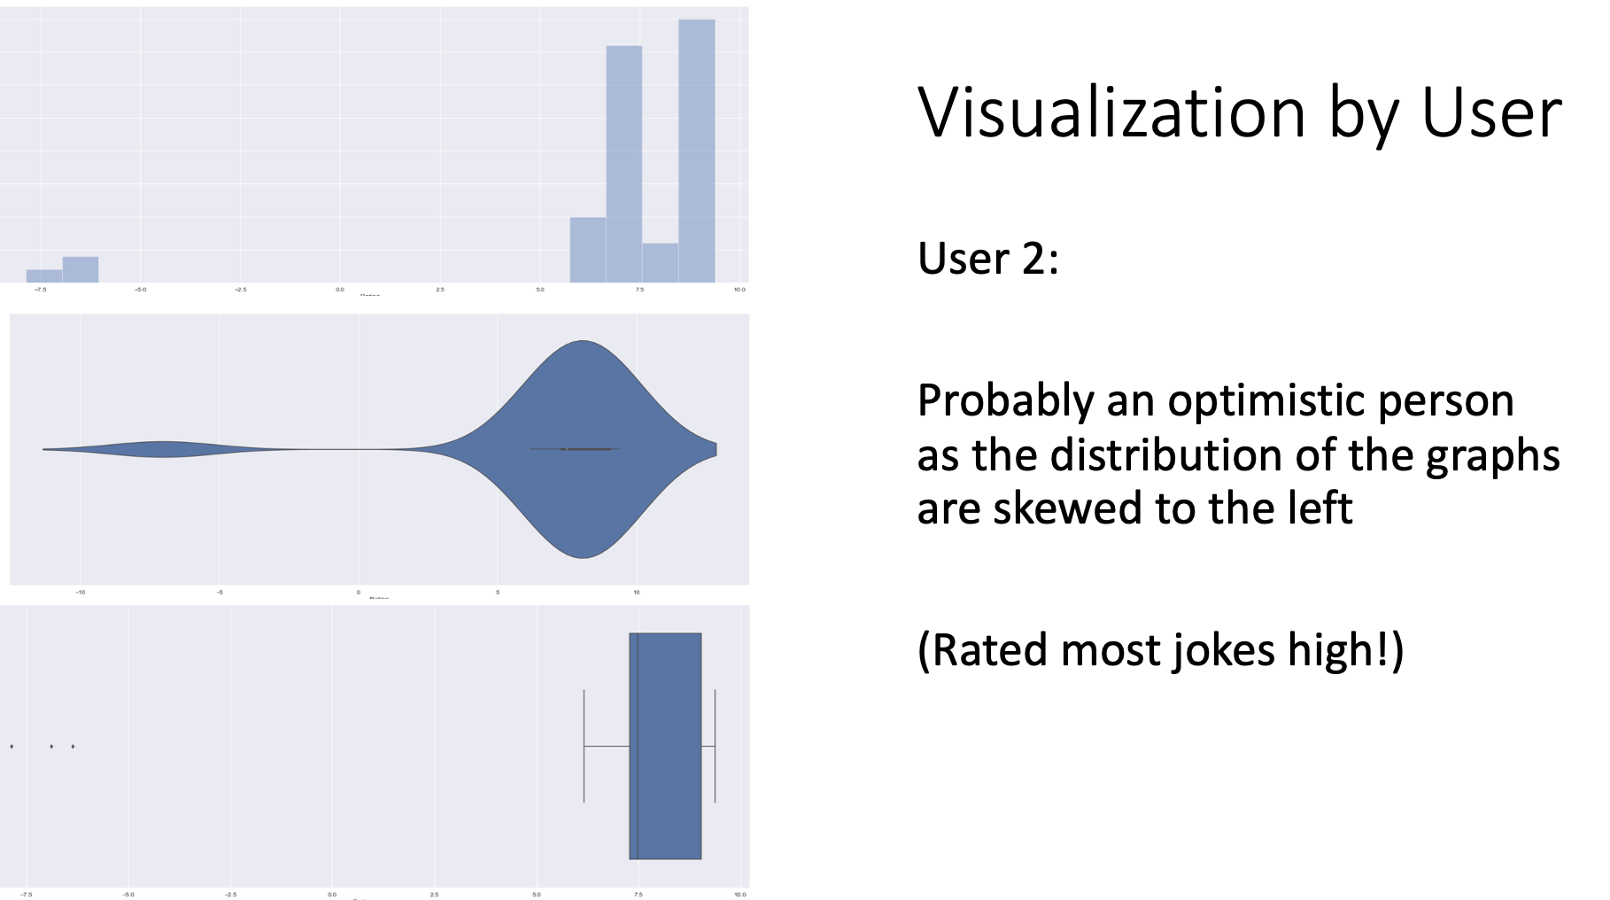

Slide 41
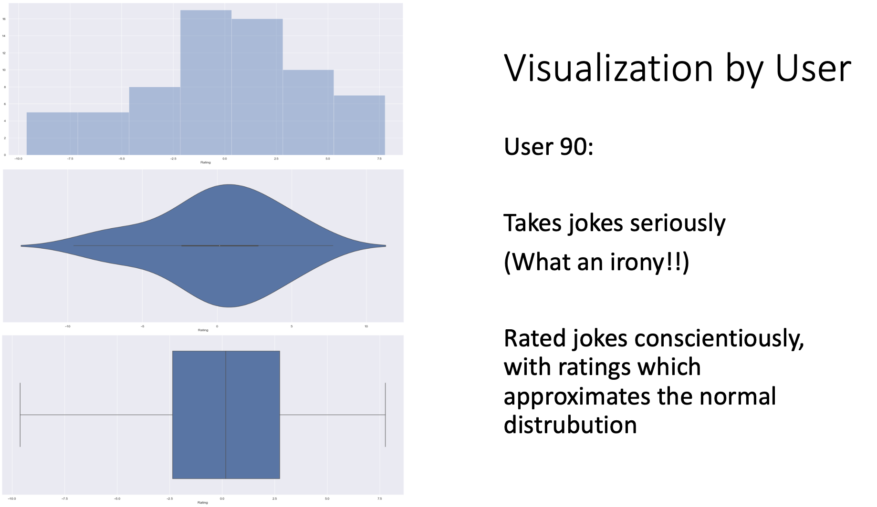

Slide 42
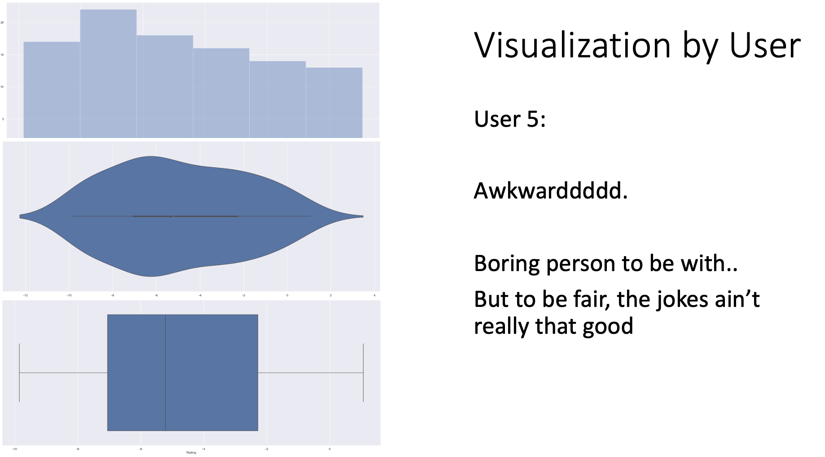

Slide 43
Visualization by Joke

Slide 44
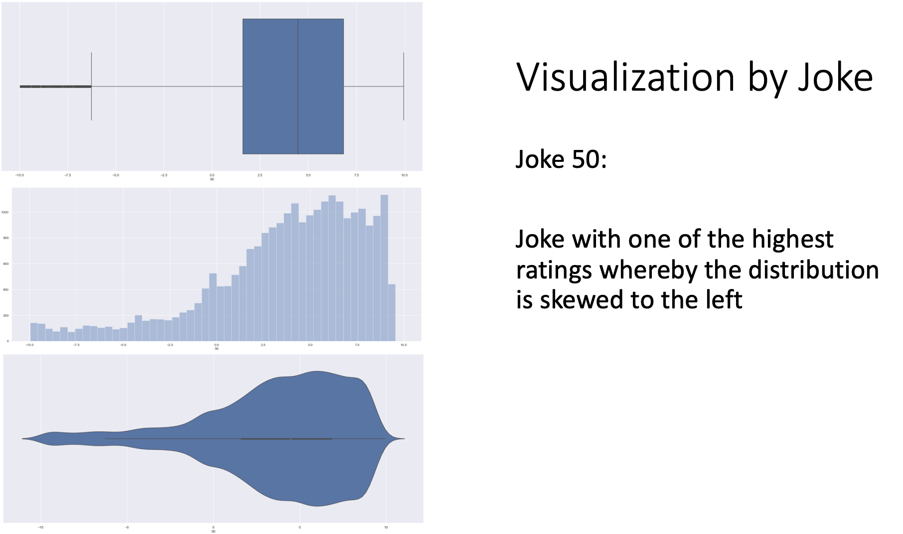

Slide 45
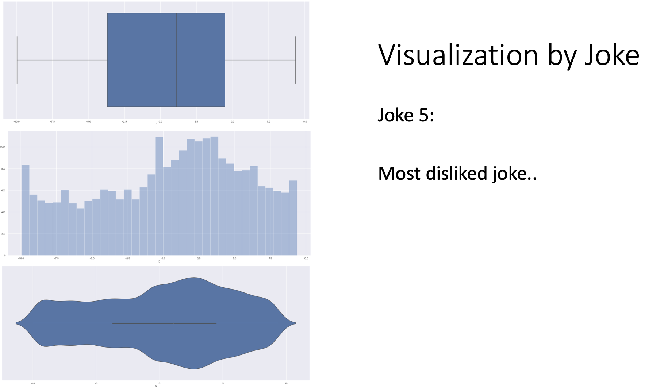

Slide 46
References
https://github.com/PacktPublishing/Hands-On-Recommendation-Systems-with-Python

Slide 47
THANKS!
Any questions?

